Slide 1


Lab. Advanced Programming
Leonardo Maria Carrozzo, 2088934
Simone Pascucci, 1895398
Gianmarco Zizzo, 1663195
UrbanWatch

Slide 2
UrbanWatch
The idea

Slide 3
UrbanWatch: the idea
Objectives of the laboratory:
Develop a distributed software application exploiting containerization paradigm
Follow a development workflow coherent with agile principles and Scrum methodology
The idea of our group has been to realize a web app in which are gathered information and reports about urban and environmental problems in Rome, such as road potholes, degraded bins, structural problems and so on.
These reports are mostly sent by citizens, that are the basic users of the
service: as an example, let's imagine that a citizen is walking in the city, he
notice that a tree seems unsafe and uses the service to indicate the problem
and the location.

Slide 4
UrbanWatch
User stories, planning and architecture

Slide 5
User Stories
User account and profile
Users need an account and a where they can manage their information
Report
Users want to be able to insert new reports, view active reports and follow the reports they are interested in
Map
Users need the city map to see the active reports
Notification
Users want to be notified when something changes in the reports they are following
Admin dashboard
Admins need a dashboard through which they can moderate and resolve reports

Slide 6
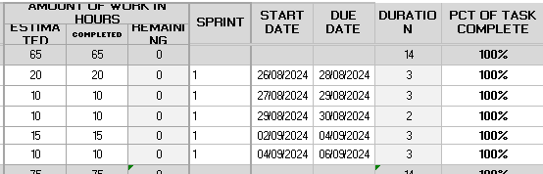
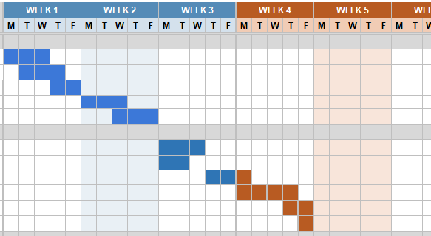
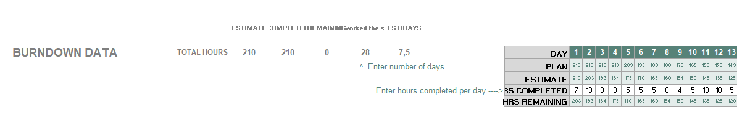

Planning
Through an excel template based on Scrum we organized our tasks and estimated:
about 210 hours of work
4 sprints, for 6 weeks of work
The full documentation is available in our project repository

Slide 7
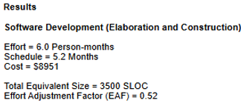
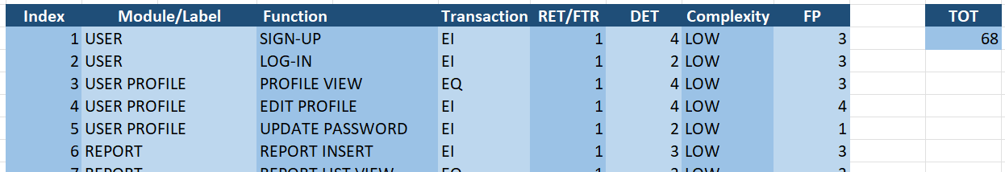
Planning
Using an online tool, we used COCOMO II to estimate our project cost…
… and we estimated a value of 68 Function points
The full documentation is available in our project repository

Slide 8
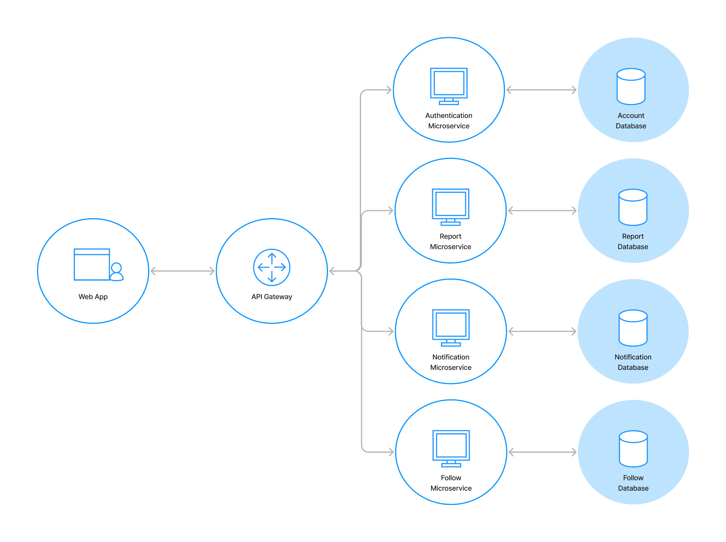
Architecture
We have three microservices:
Authentication microservice
Report microservice
Notification microservice
Follow microservice
Each microservice has its own database
Through APIs, our Web App communicates with the microservices

Slide 9
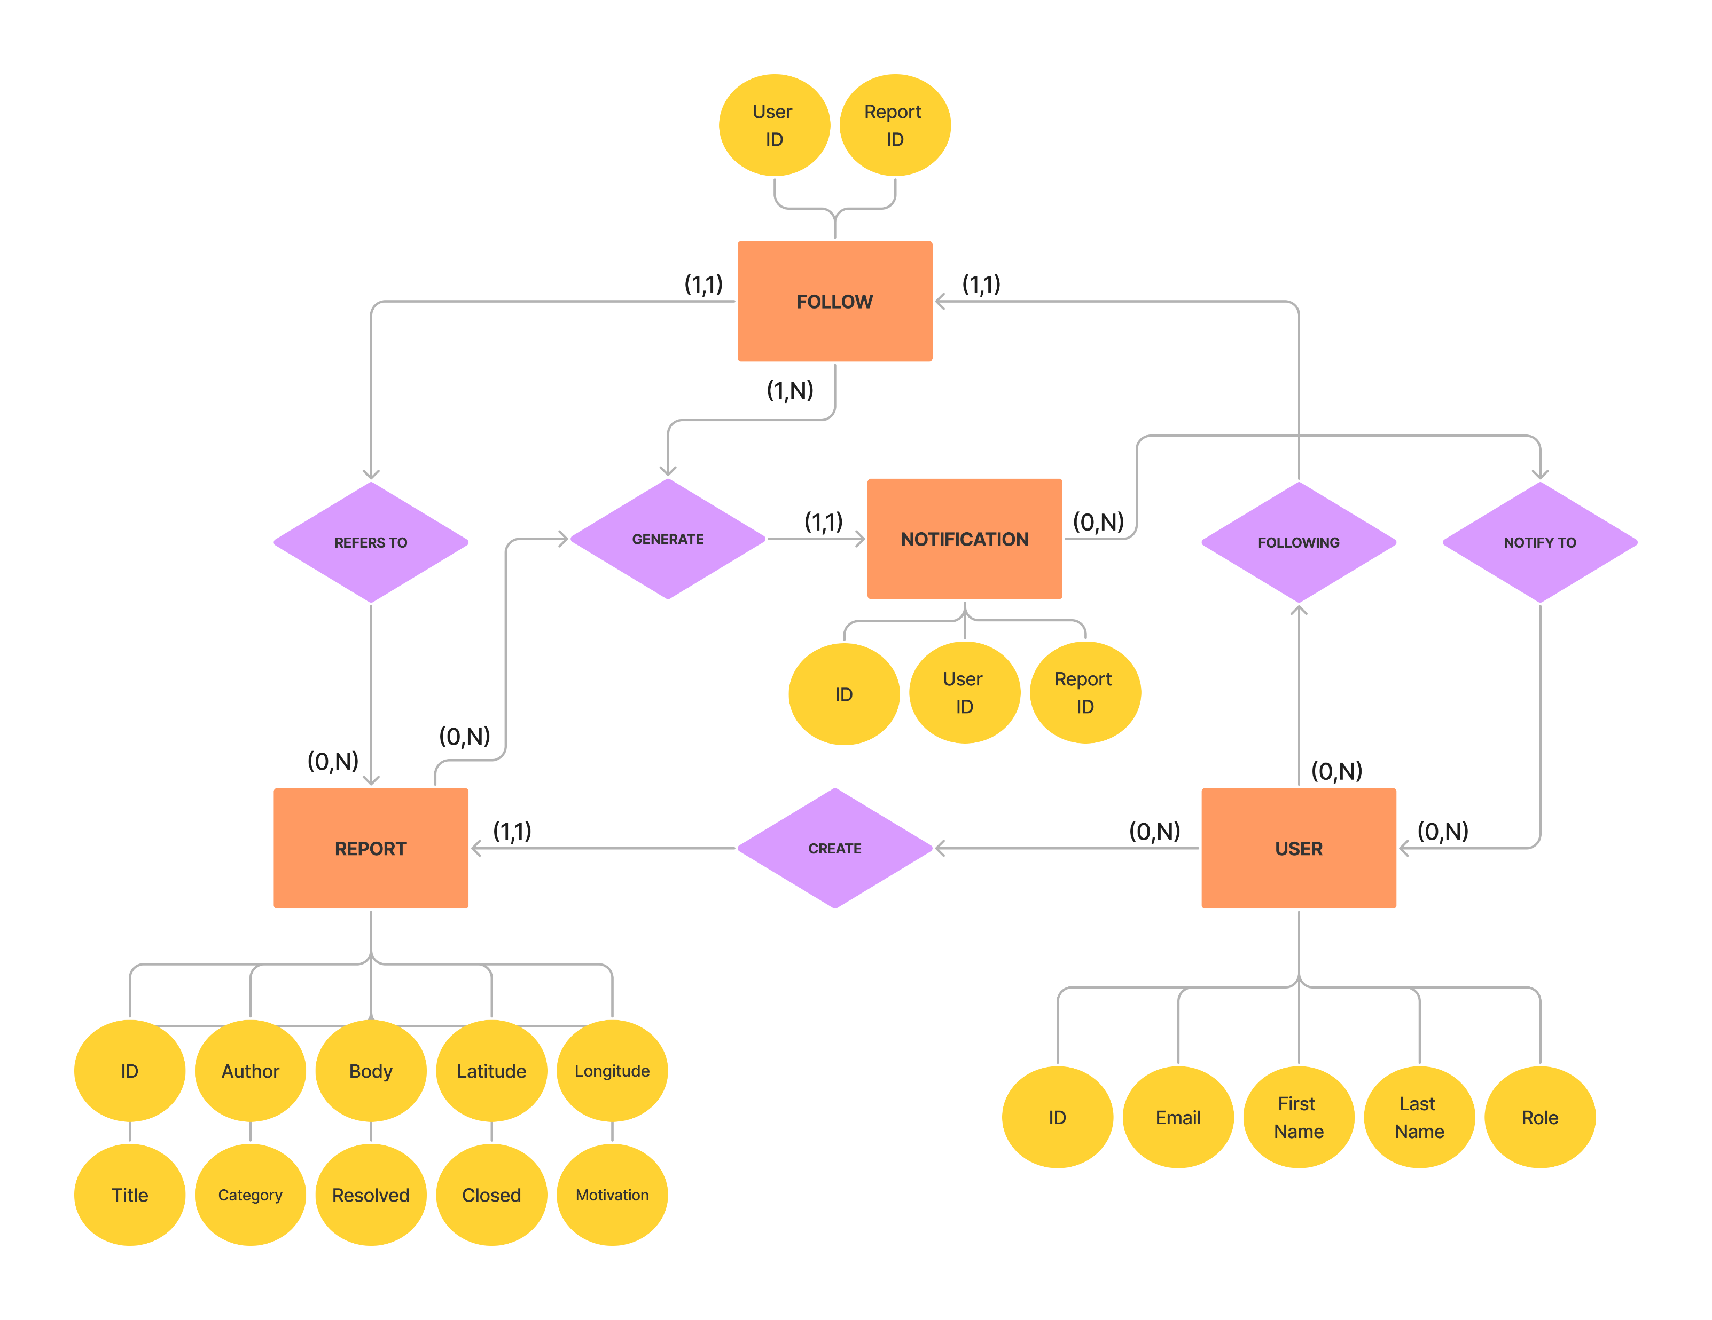
ER-Diagram

Slide 10
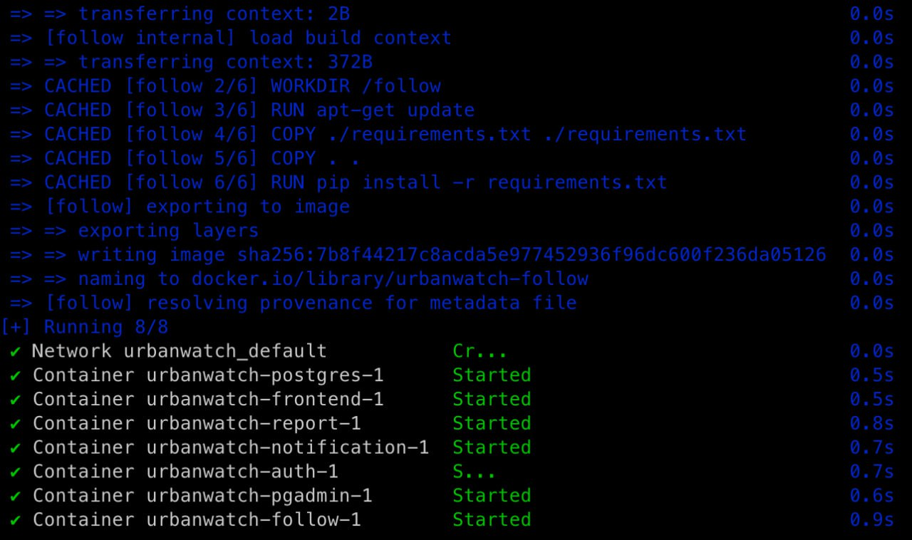
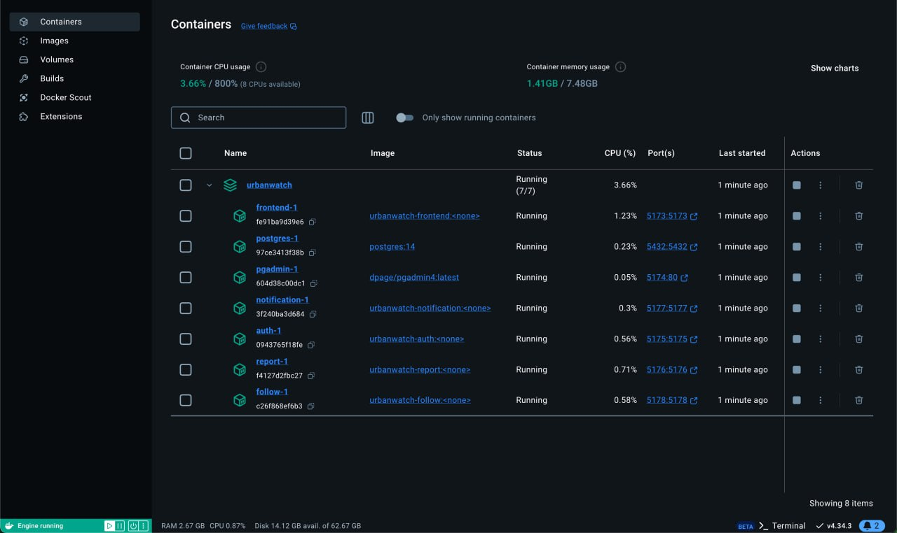
Docker Containerization
Isolated containers for each microservice

Slide 11
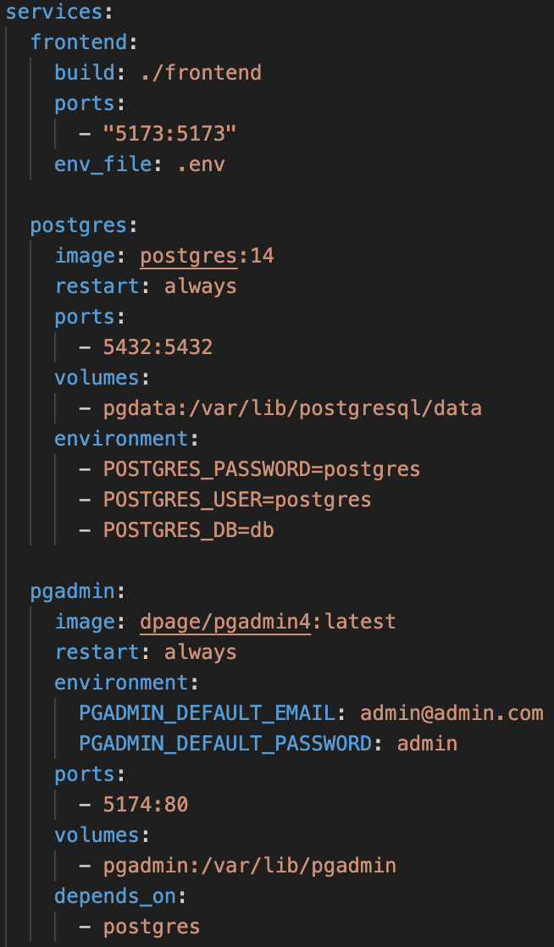
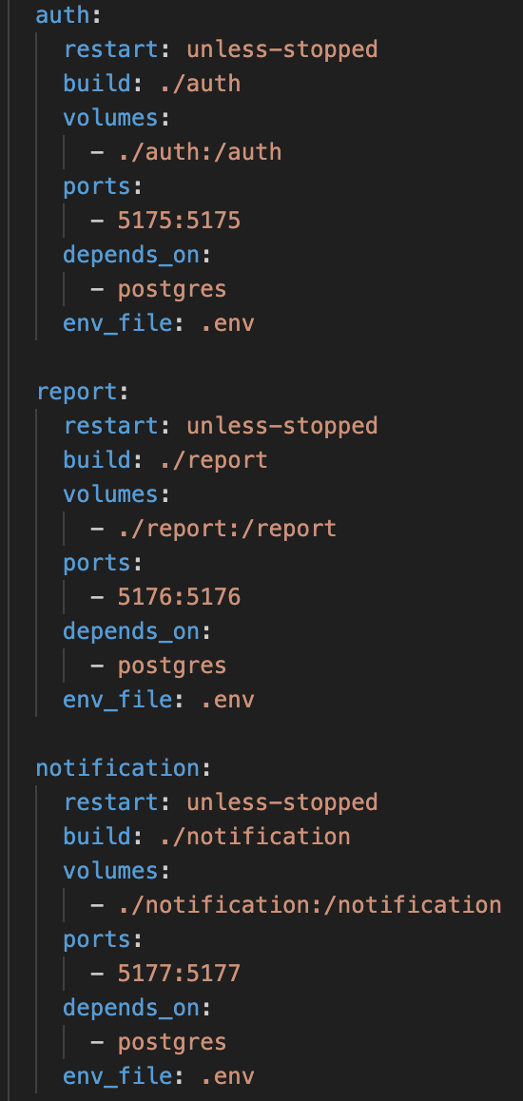
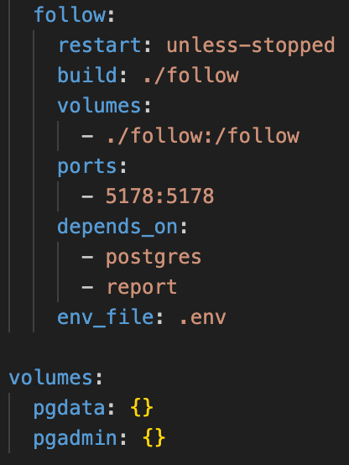
Docker Compose Orchestration Snippet
Defines all services in one place
Usage in docker compose up/down
Dependends_on to enstablish services starting order
Environment variables defined in it
Port mapping
Volume mounting for data persistency

Slide 12
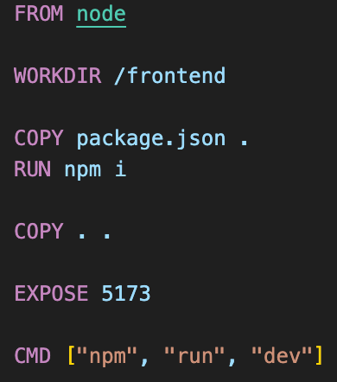
Docker File - Frontend
Base image of node
It builds, pack and serve the frontend microservice
Working directory set by using “WORKDIR” instruction
Copies the “package.json” from local to the container, then it runs “npm install”
It copies the whole working directory and exposes on port 5173
After all it runs “npm run dev” command

Slide 13
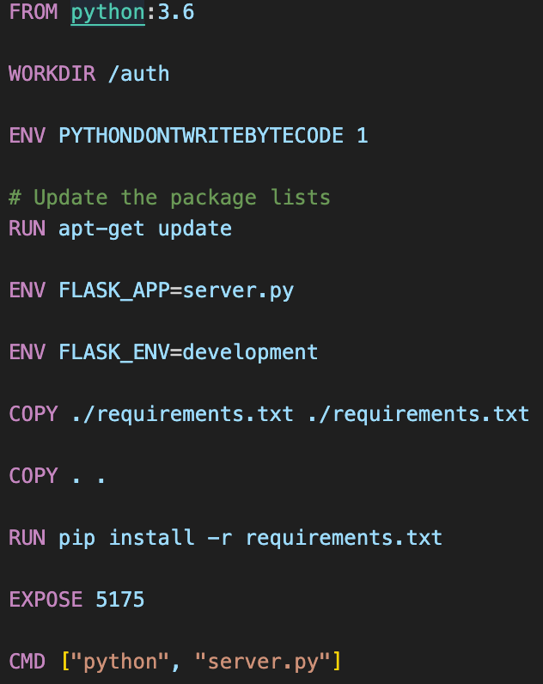
Docker File - Backend
Base image of python 3.6
Working directory set by using “WORKDIR” instruction
Copies the “requirements.txt” from local to the container, then it runs “pip install –r requirements.txt”
It copies the whole working directory and exposes on port 5175
After all it runs “python server.py” command

Slide 14
UrbanWatch
Back-end & front-end

Slide 15



About back-end
The backend has been built with Python
The Authentication microservice is responsible of what concerns about users’ account and users’ profile
The Report microservice handles the management of all operations relating to reports
The Follow microservice allows users to follow reports they are interested in
The Notification microservice is responsible of sending notifications when something changes in a report being followed

Slide 16
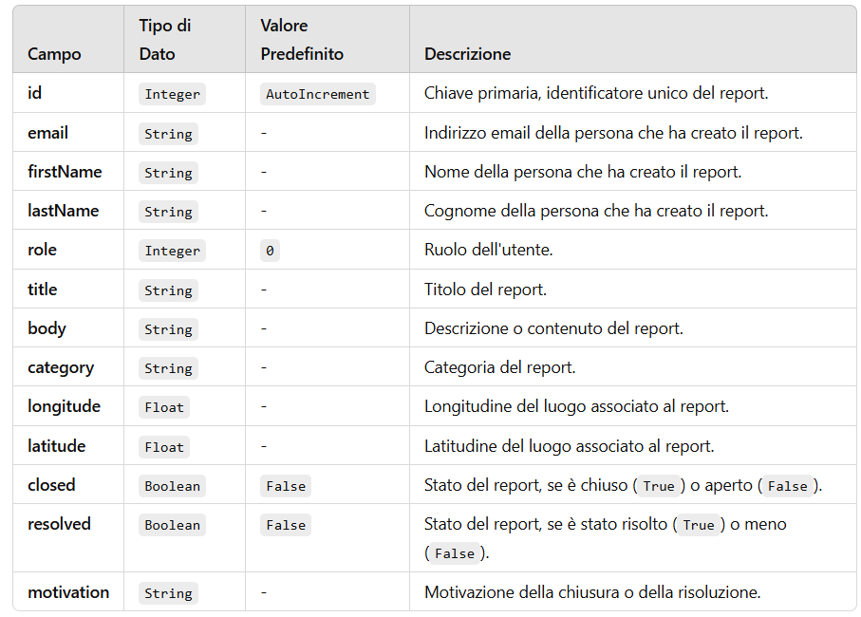
About back-end
Reports are the most important objects of UrbanWatch.
Here you can see the model:

Slide 17

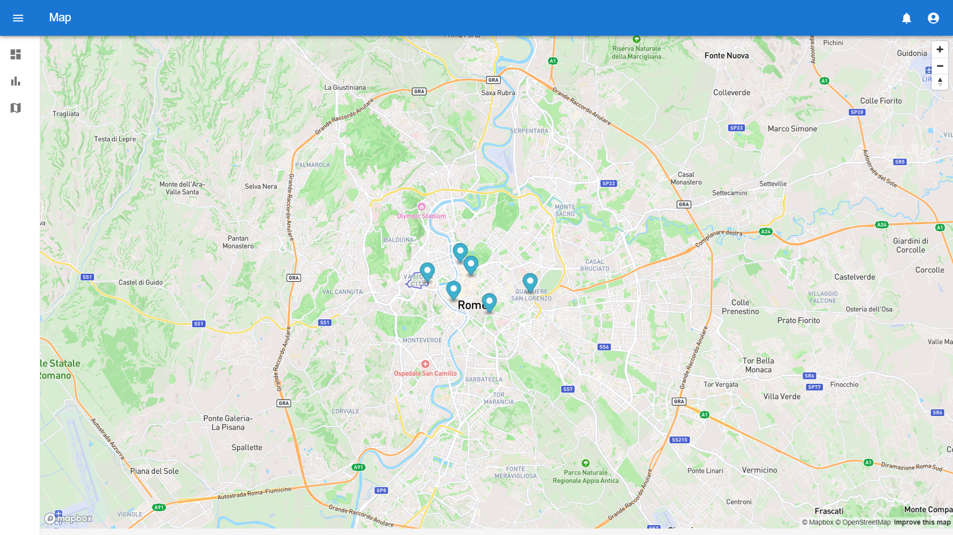

About front-end
The backend has been built with React
The main and most interesting part of our web app is undoubtedly the map, through which users can insert and view reports
The map has been implemented with

Slide 18
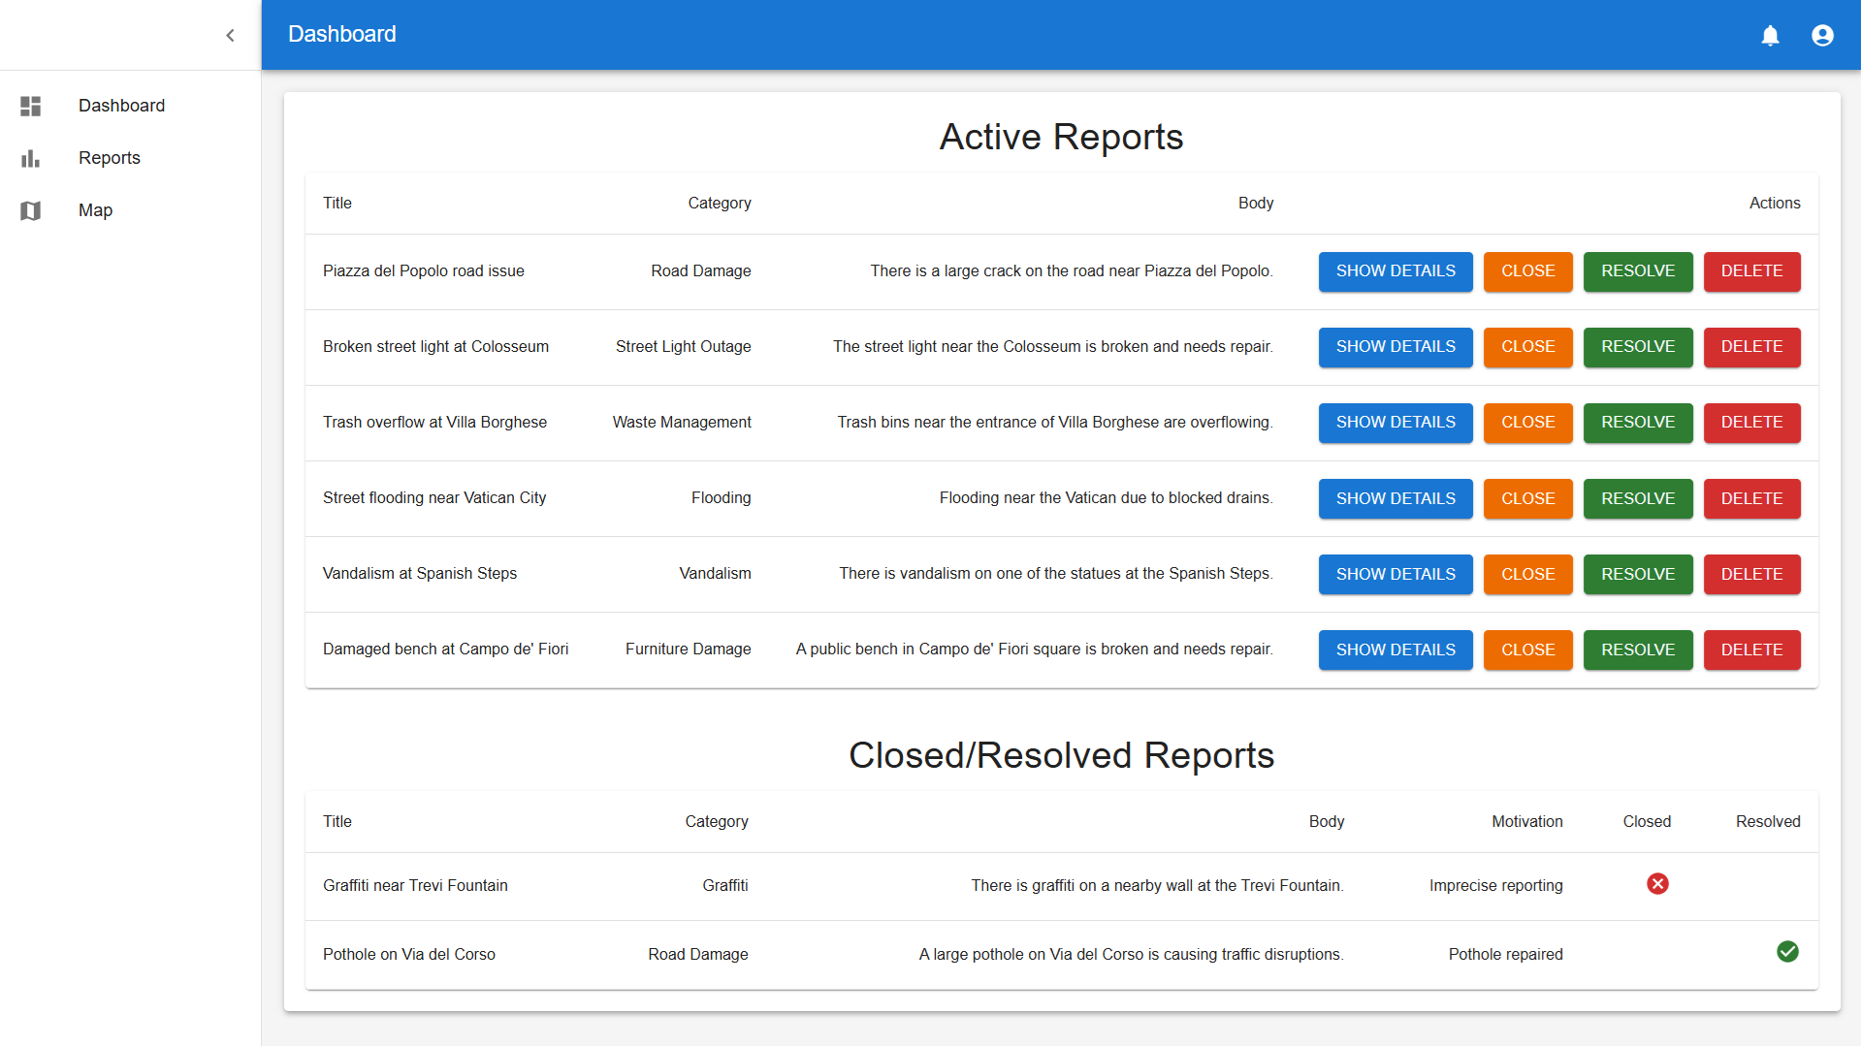
About front-end
Admins have a dashboard through which they can see all active reports, with their details, and moderate them, close them or mark them as resolved, also adding a reason.

Slide 19
UrbanWatch
Final considerations

Slide 20
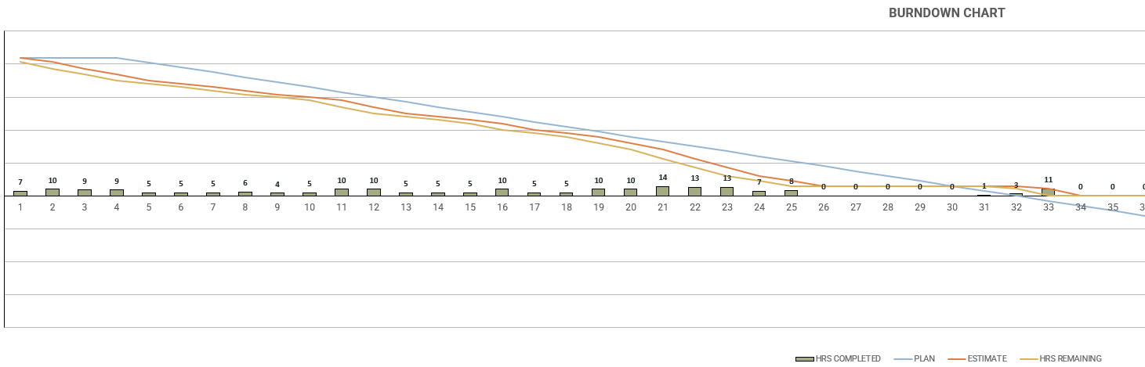
Burndown chart
From the burndown chart it turns out that development has proceeded in a fairly balanced manner and we have been always ahead of schedule, except for the last days, but only because we decided to take a break before the final testing phase

Slide 21
UrbanWatch
Thanks!

